Slide 1
SQL Server
“…hmmmmm….“
Pregatit de Marcel Soare Data: 5.07.2016
Notes:
Prezentare personala
Care este reactia cand intreb de sql
Intentiile personale referitoare la acest curs
De ce hmmmm………
3 zile pt introducere

Slide 2
Objectives
Using SSMS
Querying
Real (ex)(s)amples
Notes:
Obiective propuse a fi atinse:
Transfer de cunostinte usitate foarte frecvent
Nu se asteapta nimeni sa fie experti dupa acest curs, dar cel putin vor putea utiliza ssms si sql server
Interogari simple ale unei baze de date
administrare sumara a bazei de date

Slide 3
Agenda - Day 1
Product presentation (Microsoft SQL Server)
Technologies
Documentation
Database concepts
Database
Tables
Pk, fk
Index, trigger
Login users
Tools

Slide 4
DBMS
used by the users to access the data stored in database files and perform administrative task
software system designed to allow the definition, creation, querying, and updating of data stored in relational databases
Notes:
Serviciu sql sqlserver.exe

Slide 5
How Sql Server works
service
files
logs
Notes:
Serviciu windows – identificabil ca serviciu
Fisiere utilizate
Mdf – aleatory in functie de modul de stocare a datelor
Ndf
Ldf – utilizat la repornire si pt a inregistrat modificarile efectute asupra datelor
- Organizate secvential
Log-ul de sql server

Slide 6
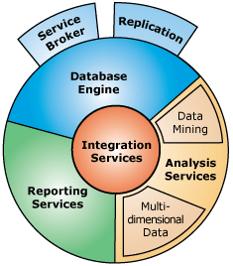
SQL Technologies
Database Engine
Reporting Services
Replication
Notes:
Enumerate cateva din tehnologiile utilizate de sql server
Lista complete din ultima versiune de sql
https://technet.microsoft.com/en-us/library/ms130214.aspx

Slide 7
Database Engine
is the core service for storing, processing and securing data.
provides controlled access and rapid transaction processing to meet the requirements of the most demanding data consuming applications within your enterprise.
instance of the Database Engine is a copy of the sqlservr.exe executable that runs as an operating system service.
features associated with database and database objects
Notes:
Link bol : https://technet.microsoft.com/en-us/library/ms187875.aspx

Slide 8
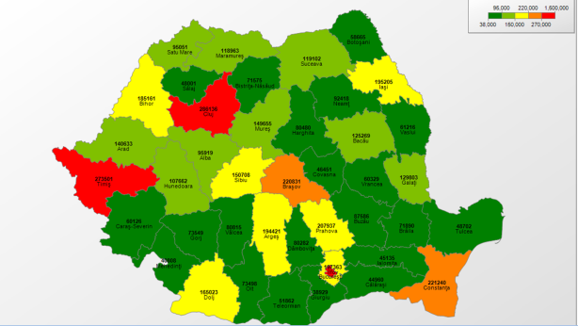
Reporting services
a rich set of tools for building and publishing enterprise reports, managing security and subscriptions, and extending the reporting functionality through a comprehensive API
Reports are defined using an XML-based language called Report Definition Language (RDL)
reports that you create can be viewed over a Web-based connection or as part of a Microsoft Windows application or SharePoint site
Notes:
Link bol : https://technet.microsoft.com/en-us/library/ms159106.aspx

Slide 9
Replication
copying and distributing data and database objects from one database to another and then synchronizing between databases to maintain consistency
distribute data to different locations and to remote or mobile users over local and wide area networks, dial-up connections, wireless connections, and the Internet
Transactional replication
Merge replication
Snapshot replication
Notes:
Link from Bol : https://technet.microsoft.com/en-us/library/ms151198.aspx

Slide 10
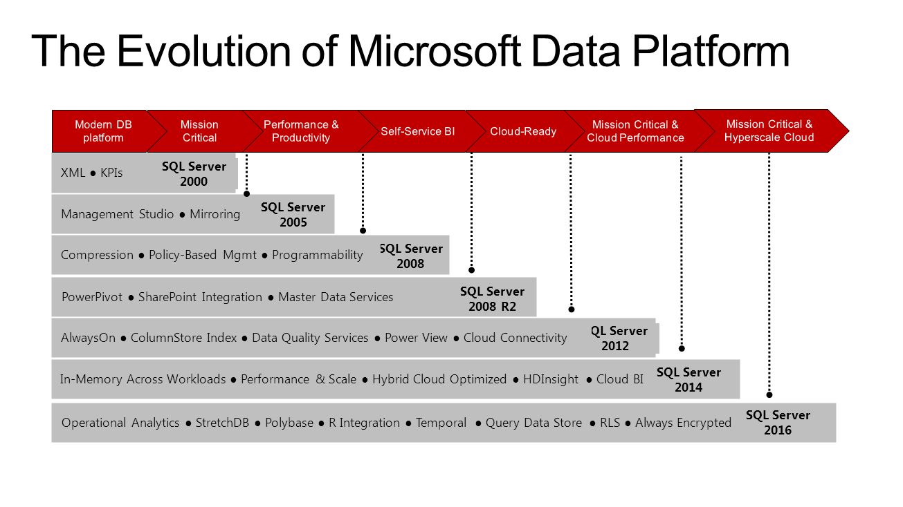
Product presentation

Slide 11
Editions
Enterprise
Business Intelligence
Standard
Web
Express With Advanced Services
Express With Tools
Express
Compact Edition
LocalDb
Developer Edition
Notes:
Information about
Editions
Versions
Details about features and editions: https://msdn.microsoft.com/library/cc645993.aspx

Slide 12
Documentation
Books on line
offline
Resources on internet
Stack overflow
Brent ozar
MVA

Slide 13
SQL Concepts
Databases
Database Management System
Tables
Tool
T-SQL
Notes:
What is SQL Server?
Software product?
Relational database management system?
Service? Yes it is a service, from a point of view
Competitors?
TSQL
definitie: Transact-SQL (T-SQL) is Microsoft's and Sybase's proprietary extension to SQL. SQL, the acronym for Structured Query Language, is a standardized computer language that was originally developed by IBM for querying, altering and defining relational databases, using declarative statements. T-SQL expands on the SQL standard to include procedural programming, local variables, various support functions for string processing, date processing, mathematics, etc. and changes to the DELETE and UPDATE statements. - definitie preluata de la Wikipedia

Slide 14
SQL Server Management Studio
is the main administration console for SQL Server
enables you to create database objects (such as databases, tables, stored procedures, views etc), view the data within your database, configure user accounts, perform backups, replication, transfer data between databases, and more
Link documentatie
Notes:
EASY WAY
Documentatie
https://msdn.microsoft.com/en-us/library/ms174173.aspx
https://msdn.microsoft.com/en-us/library/bb934498(v=sql.120).aspx
Caracteristici
Extensibil – poti dezvolta componente integrabile
Organizarea scripturilor in solutii precum la Visual Studio
Prezentare
Object Explorer
Solution Explorer
Colectie de unul sau mai multe proiecte legate intre ele (proiectul – containere utilizate pentru organizare fisierelor de admnistrare de interogare)
o solutie contine
Queries si scripturi
Connection information and files used by the queries and scripts
Query designer – modificabila in functie de ce operatie executi ( data editezi o tabele apare structura tabelei, daca concepi in script apar statementurile de SQL)
Flux de utilizare
deschidere fereastra de conectare la baza de date
Object Explorer -

Slide 15
Databases
a database in SQL Server is made up of a collection of objects that stores a specific set of structured data
data is organized as records (rows), fields (columns)
each instance of SQL Server can contain one or many databases
databases are stored in the file system in files (ldf, mdf, ndf)
database objects
Tables
Views
Stored procedures
Functions
Notes:
Definitie – baza de date
Ce permite o baza de date dpd al datelor -It allows you to input, manage, organize, and retrieve data quickly
Files used (extensions): mdf, ndf – contine datele stocate in baza, ldf-ul contine tranzactiile inregistrate in baza de date
Definitie Tranzactie: secvente de cod rulate pentru alterarea informatiilor din baza de date, construite ca un tot unitar. Caracterizate prin atomicitate, consistenta, izolare, durabilitate
Database objects: https://msdn.microsoft.com/en-us/library/hh230827.aspx
Cand se instealeaza SQL Server sunt create 4 baze de date de sistem
master – informatii de sistem (user accounts, setari nivel de server, informatii despre bazele de date) - catalog al bazelor de date
model – template pentru bazele de date create
msdb – utilizata de SQL Agent pentru alerge si job-uri rulate periodice
tembdb – utilizata pentru obiecte temporare
Prezentate sumar obiectele cele mai uzitate: tables, views, stored procedures
----------------------------------------
http://technet.microsoft.com/en-us/library/ms179422(v=sql.105).aspx
http://technet.microsoft.com/en-us/library/ms179422.aspx
OLTP
Data Warehouse
Files: mdf si ldf
Serviciu:
http://technet.microsoft.com/en-us/library/ms175198(v=sql.105).aspx
---create database
http://technet.microsoft.com/en-us/library/ms176061(v=sql.105).aspx

Slide 16
Tables
A table contains a collection of rows, also referred to as records or tuples, and columns, also referred to as attributes
Each column in the table is designed to store a certain type of information, for example, dates, names, dollar amounts, and numbers
number of tables in a database is limited only by the number of objects allowed in a database (2,147,483,647)
user-defined table can have up to 1,024 columns
Notes:
---tables on bol
http://technet.microsoft.com/en-us/library/ms189084.aspx

Slide 17
Tables (2)
Customer | Product | Quantity | Unit Price
Vasilescu Ion | Vin alb | 2 | 10
Gheorghe Ion | Apa minerala | 2 | 10
Popescu Ion | Vin rosu | 10 | 199,99
Vasil Ion | NULL | NULL | NULL
Notes:
Coloana
Rand – tuplu
Se observa ca folosim tipuri de date pentru exprimarea informatiilor stocate in coloana.

Slide 18
Data Types
Exact numerics(int, decimal, money)
Approximate numerics (float, real)
Date and time (date, datetime2, datetime, time)
Character strings (char, varchar)
Unicode character strings (nchar, nvarchar)
Binary strings (binary, varbinary)
Other data types (hierarchy id, uniqueidentifier)
Notes:
Link din bol: http://msdn.microsoft.com/en-us/library/ms187752.aspx
In functie de intervalul posibil de valori avem : bigint, smallint, tinyint; aici studentii deschid link-ul si identifica ei ce interval corespunde fiecarui tip de date
De intrebat cu documentatia in fata care este diferenta intre datetime2 si datetime,
Explicatie diferenta intre n si varchar
nchar and nvarchar can store Unicode characters.
char and varchar cannot store Unicode characters.
char and nchar are fixed-length which will reserve storage space for number of characters you specify even if you don't use up all that space.
varchar and nvarchar are variable-length which will only use up spaces for the characters you store. It will not reserve storage like char or nchar.

Slide 19
SSMS - Working Scenario
Create Database
Create Table
Notes:
Create a database called Store
Add a table called Product: Identificator, Nume, Categorie
Add a table called Storag: Produs, Furnizor, Cantitate
Add a table called Address: identificator, strada, localitate, judet
Add several records using ssms on each table
Show the tsql created
For the above actions use:
https://msdn.microsoft.com/en-us/library/jj590844(v=sql.120).aspx

Slide 20
Constraints
Data integrity
Referential integrity
Notes:
Constraint:
are used to specify rules for the data in a table
let you define the way the Database Engine automatically enforces the integrity of a database
Data integrity:
refers to each occurrence of a column having a correct data value. The data values must be of the right data type and in the correct domain
The following objects are used to maintain both types of integrity:
Constraints
Defaults
DML Triggers

Slide 21
Primary key
a column or combination of columns that contain values that uniquely identify each row in the table
enforces the entity integrity of the table
Identity columns
Notes:
When you specify a primary key constraint for a table, the Database Engine enforces data uniqueness by automatically creating a unique index for the primary key columns. This index also permits fast access to data when the primary key is used in queries. If a primary key constraint is defined on more than one column, values may be duplicated within one column, but each combination of values from all the columns in the primary key constraint definition must be unique.
Limitation
A table can contain only one primary key constraint.
A primary key cannot exceed 16 columns and a total key length of 900 bytes.
The index generated by a primary key constraint cannot cause the number of indexes on the table to exceed 999 nonclustered indexes and 1 clustered index.
If clustered or nonclustered is not specified for a primary key constraint, clustered is used if there no clustered index on the table.
All columns defined within a primary key constraint must be defined as not null. If nullability is not specified, all columns participating in a primary key constraint have their nullability set to not null.
If a primary key is defined on a CLR user-defined type column, the implementation of the type must support binary ordering.

Slide 22
Foreign key
a column or combination of columns that is used to establish and enforce a link between the data in two tables to control the data that can be stored in the foreign key table
Notes:
A link is created between two tables when the column or columns that hold the primary key value for one table are referenced by the column or columns in another table. This column becomes a foreign key in the second table.
Related to a primary key
Although the main purpose of a foreign key constraint is to control the data that can be stored in the foreign key table, it also controls changes to data in the primary key table

Slide 23
SSMS - Working Scenario
Alter table
Primary key
Foreign key
Create relations
1 – 1
1- many
Many - many
Notes:
Enter data using ssms
Rename identificator columns in id.
Add identity to ID columns
Create a foreign key between product and category
https://en.wikipedia.org/wiki/Database_normalization
http://www.tutorialspoint.com/sql/first-normal-form.htm
http://www.tutorialspoint.com/sql/second-normal-form.htm

Slide 24
Homework
Create a database : City
Judet
Localitate
Adresa
Persoana
Create relations between tables
1 – 1
1- many
Many - many
Notes:
Judet: cheie primara, denumirea judetului, cod judet
Localitate: cheie primara, judet (fk)
Adresa: strada, localitate, judet
Persoana: adrese multiple, dependente de tipul adresei
Folositi tipurile de date explicate si dimensionate corespunzator: Localitate sa nu contina mai putine caractere sau mai multe caractere

Slide 25
SQL Server
“DML Statements”
Pregatit de Marcel Soare Data: 27.04.2015

Slide 26
Agenda day 2
^{Simple Statements}
^{Retrieve data}
^{Filter}
^{Joins /union}
^{Ordering}
^{Aggregate}
Notes:
DML si DDL
Declare
Varibile de tip tabel

Slide 27
T-SQL
is the language used to administer instances of the SQL Server Database Engine, to create and manage database objects, and to insert, retrieve, modify, and delete data
is an extension of the language defined in the SQL standards published by the International Standards Organization (ISO) and the American National Standards Institute (ANSI)
Data Definition Language
Data Manipulation Language
Notes:
https://msdn.microsoft.com/en-us/library/bb510741.aspx
https://technet.microsoft.com/en-us/library/ms166026(v=sql.90).aspx
DDL: https://technet.microsoft.com/en-US/library/ms190281(v=sql.90).aspx
DML: https://technet.microsoft.com/en-US/library/ms177591(v=sql.90).aspx

Slide 28
P
Programming Concepts
Programs are collections of instructions that tell a computer how to interact with the user
Sequence of commands (The right commands in the right order)
Variables
Operators
Constants
Conditional structures
Looping structures
Notes:
Strucura unui program
Scripts
---
Variables
Variables are place holders for data a program might use or manipulate. Variables are given names so that we can assign values to them and refer to them later to read the values. Variables typically store values of a given type. Types generally include:
Integer – to store integer or “whole” numbers
Real – to store real or fractional numbers (also called float to indicate a floating point number)
Character – A single character such as a letter of the alphabet or punctuation.
String – A collection of characters
In computer programming, a variable is a storage location and an associated symbolic name which contains some known or unknown quantity or information, a value.
Operators
Boolean are three Boolean operators: AND, OR and NOT. These operators are written differently depending on the language being used.
Comparison operators
Boolean expressions often involve comparison operators that can be evaluated to determine if they are True or False.
Constants
--
Statements

Slide 29
Simple Statements
USE <database>
DECLARE @variableName <dataype>
@@
Notes:
USE – pentru a utiliza o baza de date
Definitia unei variabile (DECLARE)
Utilizarea constantelor
TSQL – limbaj de interogare

Slide 30
CRUD
^{INSERT}
^{SELECT}
^{UPDATE}
^{DELETE}
Notes:
Select into
Insert
Update
Delete

Slide 31
SELECT - components
SELECT <columns>
FROM <tables>
WHERE <conditions>
GROUP BY <columns>
HAVING <conditions>
ORDER BY <columns>
Link bol
Notes:
Topics:
most used with samples
Each one has a complete detail help section in BOL
Retrieves rows from the database and enables the selection of one or many rows or columns from one or many tables in SQL Server 2012
Complex syntax show only most used clauses
Samples with expressions as columns
Link Bol : https://msdn.microsoft.com/en-us/library/ms189499(v=sql.110).aspx

Slide 32
Query logical processing
1. SELECT
2. FROM
3. WHERE
4. GROUP BY
5. HAVING
6. ORDER BY
1. FROM
2. WHERE
3. GROUP BY
4. HAVING
5. SELECT
6. ORDER BY
Notes:
FROM clause has two main roles:
It’s the clause where you indicate the tables that you want to query
It’s the clause where you can apply table operators like joins to input tables
is the first clause to be evaluated logically
assign an alias to a table, you basically rename the table for the duration of the query
SELECT clause of a query has two main roles:
It evaluates expressions that define the attributes in the query’s result, assigning them with aliases if needed
Using a DISTINCT clause, you can eliminate duplicate rows in the result if needed
How about NULL
Filtering columns of type
String
DateTime
Range - BETWEEN
Another type of filtering
Top
OFFSET – FETCH
GROUP BY
HAVING
ORDER BY

Slide 33
SELECT
SELECT chooses columns
Convention: List columns on separate lines
*
link
Notes:
Specifies the columns to be returned by the query
Chooses columns
Alias for columns, but pay attention to reserved name
Use calculation on columns, sample on how to use operator on columns, insist on +operator
Not/how to use *
Most used arguments for this statement: TOP, columns alias
Topics: allow functions on select clause
https://msdn.microsoft.com/en-us/library/ms189499.aspx
Removing duplicates statements

Slide 34
WHERE
WHERE <conditions>
Specifies the search condition for the rows returned by the query
Notes:
Filtering clause from select statement.
Search condition = one or more predicate
•Creating Predicates
•Predicate Keywords : BETWEEN, [NOT] IN, ALL, ANY or SOME, [NOT] EXISTS
•Combining Predicates
•Querying Strings with LIKE
Topics : only true condition
apply function on where clause

Slide 35
Predicates
<column> <operator> <value>
Operators
= (Equals)
<> (Not equals - != also works)
< (Less than)
> (Greater than)
<= (Less than or equal to)
= (Greater than or equal to)
Notes:
There is no limit to the number of predicates that can be included in a search condition

Slide 36
Predicates keywords
BETWEEN
– Inclusive range
<column> BETWEEN <value> and <value>
[NOT] IN
–Value is contained in list of values
Other Keywords
– ALL
– ANY or SOME
– [NOT] EXISTS
Notes:
There is no limit to the number of predicates that can be included in a search condition
^{Llink} between
https://msdn.microsoft.com/en-us/library/ms187922.aspx

Slide 37
Multiple Predicates
AND
Both sides must match
OR
Either side can match
Notes:
Sample from scripts are
--
--

Slide 38
String predicates - Like
LIKE returns TRUE if the specified expression matches the specified pattern
Sample expression <column> LIKE <expression>
LIKE allows wild card characters
% - Zero or more characters
_ - One character
[ ] – Used for a range
[afr] – Will find a, f, or r
[a-f] – Will find a, b, c, d, e, or f
[^] – Any character except what is in the range
Escape character to search for special characters
- ProductCode LIKE '\[pc-%\]' ESCAPE '\‘ Will search for [pc-%]
Notes:
Definition:
Determines whether a specific character string matches a specified pattern. A pattern can include regular characters and wildcard characters.
If any one of the arguments is not of character string data type, the SQL Server Database Engine converts it to character string data type, if it is possible
Topics:
patterns
indexes
pay attention for complex strings
results returned are true
escape special characters
Link from bol: https://msdn.microsoft.com/en-us/library/ms179859.aspx
Sample from scripts are:

Slide 39
NULL
It is blank.
It is empty.
It is zero.
It is nothing.
It is missing value.
It is the lowest value.
It is ignorable value.
It is optional value.
It is invalid.
It is void.
Notes:
Topics
- what is NULL - NULL means 'NO RESULT' or 'UNKNOWN VALUE' which is not equals to itself
- filtering data with Null values on columns
- NULL operators
IS NULL
IS NOT NULL
Any operation involving null evaluates to “unknown”
Link bol: https://technet.microsoft.com/en-us/library/ms191504%28v=sql.105%29.aspx
Samples from scripts

Slide 40
NULL (2)
A value of NULL indicates that the value is unknown
A value of NULL is different from an empty or zero value
No two NULL values are equal
Comparisons between two null values, or between a NULL and any other value, return unknown because the value of each NULL is unknown
Notes:
Topics
- what is NULL - NULL means 'NO RESULT' or 'UNKNOWN VALUE' which is not equals to itself
- filtering data with Null values on columns
- NULL operators
IS NULL
IS NOT NULL
Any operation involving null evaluates to “unknown”
Link bol: https://technet.microsoft.com/en-us/library/ms191504%28v=sql.105%29.aspx
Samples from scripts

Slide 41
ORDER BY
Order the result set of a query by the specified column list
ORDER BY order_by_expression
Notes:
Topics :
The order in which rows are returned in a result set are not guaranteed unless an ORDER BY clause is specified
Multiple search
Best practices : Avoid specifying integers in the ORDER BY clause as positional representations of the columns in the select list. For example, although a statement such as SELECT ProductID, Name FROM Production.Production ORDER BY 2 is valid, the statement is not as easily understood by others compared with specifying the actual column name. In addition, changes to the select list, such as changing the column order or adding new columns, will require modifying the ORDER BY clause in order to avoid unexpected results.
Using in conjuction with top can limit the number on rows returned
Bol link : https://msdn.microsoft.com/en-us/library/ms188385.aspx

Slide 42
GROUP BY
Groups a selected set of rows into a set of summary rows by the values of one or more columns or expressions
One row is returned for each group
Aggregate functions (AVG, MIN, SUM, COUNT, MAX)
Notes:
Topics:
what is a group
aggregate functions in conjuction with groups
Aggregate functions in the SELECT clause <select> list provide information about each group instead of individual rows
only one group by, multiple groups (trailing group by)
syntax
Sample from scripts
Bol link:
https://msdn.microsoft.com/en-us/library/ms177673.aspx
https://msdn.microsoft.com/en-us/library/ms173454.aspx (aggregate functions0

Slide 43
HAVING
search condition for a group or an aggregate
is typically used in a GROUP BY clause
When GROUP BY is not used, HAVING behaves like a WHERE clause
Notes:
Topics :
filter for groups
syntax
Bol link: https://msdn.microsoft.com/en-us/library/ms180199.aspx

Slide 44

JOINs

Slide 45
JOINs
INNER JOIN (the typical join operation, which uses some comparison operator like = or <>).
INNER JOIN return rows only when there is at least one row from both tables that matches the join condition
INNER JOIN joins eliminate the rows that do not match with a row from the other table
Outer joins return all rows from at least one of the tables (LEFT, RIGHT)
LEFT JOIN keyword returns all rows from the left table, with the matching rows in the right table. The result is NULL in the right side when there is no match
RIGHT JOIN keyword returns all rows from the right table, with the matching rows in the left table. The result is NULL in the left side when there is no match
Notes:
Topics:
purpose: showing date from multiple tables
mainly used types of join
Join conditions can be specified in either the FROM or WHERE clauses
limit on join???
subquery
combining join (left + inner join)
Bol link:
https://msdn.microsoft.com/en-us/library/ms191472.aspx
https://msdn.microsoft.com/en-us/library/ms187518.aspx
https://msdn.microsoft.com/en-us/library/ms191430%28v=sql.105%29.aspx
Sample from scripts

Slide 46
SQL Server
“The other objects, design”
Pregatit de Marcel Soare Data: 27.04.2015
Notes:
Administrarea serverului de baze de date
Security
User
Logins
Schemas
back-up restore

Slide 47
Agenda day 3
^{Insert, Update, Delete, Merge}
^{Stored procedures}
^{Views}
^{Triggers}
^{Indexes}
Notes:
Understanding SQL Server Security
Securing SQL Server databases and objects
Using SSMS to backup SQL Server databases
Using SSMS to restore SQL Server databases

Slide 48
INSERT
Adds one or more rows to a table or a view in SQL Server
Syntax : INSERT INTO <object> (<column_list>) VALUES (<value_list>);
Notes:
Topics
Syntax: insert <column> values ()
Permissions
Create new tables
use INSERT INTO <target_table> SELECT <columns> FROM <source_table> to efficiently transfer a large number of rows from one table, such as a staging table, to another table with minimal logging
transaction
impact on performance
Apply functions on selected columns
IDENTITY columns – used for primary keys
SEQUENCE – used also for primary keys
Bol Link
https://msdn.microsoft.com/en-us/library/ms174335.aspx#InsertExamples

Slide 49
UPDATE
UPDATE <table>
SET <column = expression>
FROM <tables>
WHERE <conditions>
Notes:
https://msdn.microsoft.com/en-us/library/ms177523.aspx

Slide 50
DELETE
DELETE [FROM] <tables>
WHERE <conditions>
Notes:
https://msdn.microsoft.com/en-us/library/ms189835.aspx

Slide 51
MERGE

Slide 52
Stored Procedure

Slide 53
VIEW

Slide 54
TRANSACTIONS

Slide 55
DATABSE SECURITY
Securing your database content is a critical part of a DBA’s job. The design, testing, and implementation of security is necessary to ensure that confidentiality is not compromised
Securables are the server, database, and objects a database contains
Principals are the individuals, groups, and processes granted access to SQL Server
Permissions are granted to a principal for every SQL Server securable

Slide 56
LOGINS AND ACCOUNTS
Three tiered approach to accessing content
1. SQL Server access - a login is a security principal that can be authenticated by a secure system to provide a user access to SQL Server
2. Database access - a database user is mapped to a SQL login and provides a user or group access to a database
3. Object access – permissions are applied at the object level to provide the appropriate access to the objects within the database

Slide 57
BACK-UP

Slide 58
RESTORE

Slide 59
Thank you!

